Slide 1

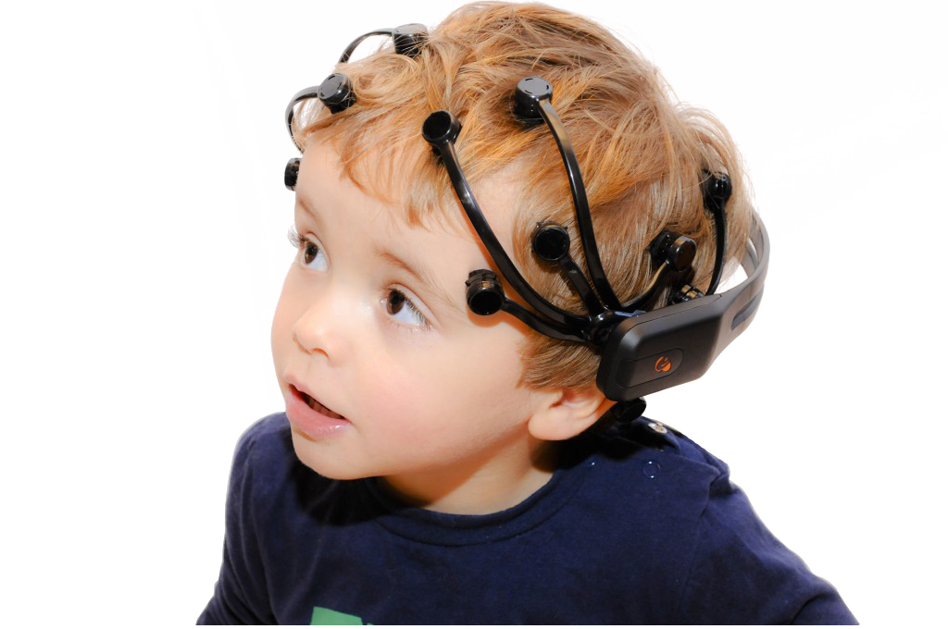
Superhuman
Team Members :
101503039 Ansh Arora
101503046 Arshjot Kaur
101683032 Aarti Sharma
101553002 Akhil Gupta
Mentors :
Mr. Shatrughan Modi

Slide 2
Project Overview
The world has become easier than our ancestors could ever think of.
Taking this simplicity forward, we are bringing to you, Superhuman.
Going a bit deeper, we’ll make use of some elementary brain science.
After getting our data, we train our model on the gathered data to perform a variety of tasks which is only bounded by one’s creativity.
Notes:
With this, you need not move your fingers, just think and you’re done.
fact that every thought in our mind is accompanied by racing neurons across the head’s surface
These neurons lead to different points of our scalp being at slightly different potentials. With an EEG (electroencephalography) device we measure this difference.
Moving wheelchairs, driving cars, playing games, enhancing Meditation sessions.

Slide 3
Need Analysis
Time is becoming as crucial an entity as money. We aim to reduce efforts and cut the time required in jobs.
It would reduce the dependence of day to day chores on limbs.
Elderly people would benefit as well.
Apart from improving lifestyles, this can also be used for leisure activities like gaming.
Notes:
So, for example, a man with no hands can switch on or off lights of his/her room without calling out for help. A person with problems in walking, would no longer need to rely on someone else for steering his wheelchair.
People with physical disabilities will no longer be dependent on others for fulfilling basic requirements.
The device can detect when the driver is about to doze off and can warn him/her by sounding alarms or flashing lights thus preventing about 1/5th of all road accidents.
An EEG system could prompt a video game character to move forward on a screen if electrodes pick up brain wave patterns associated with smiling. The character could then stop moving if a pattern for frown is detected.

Slide 4
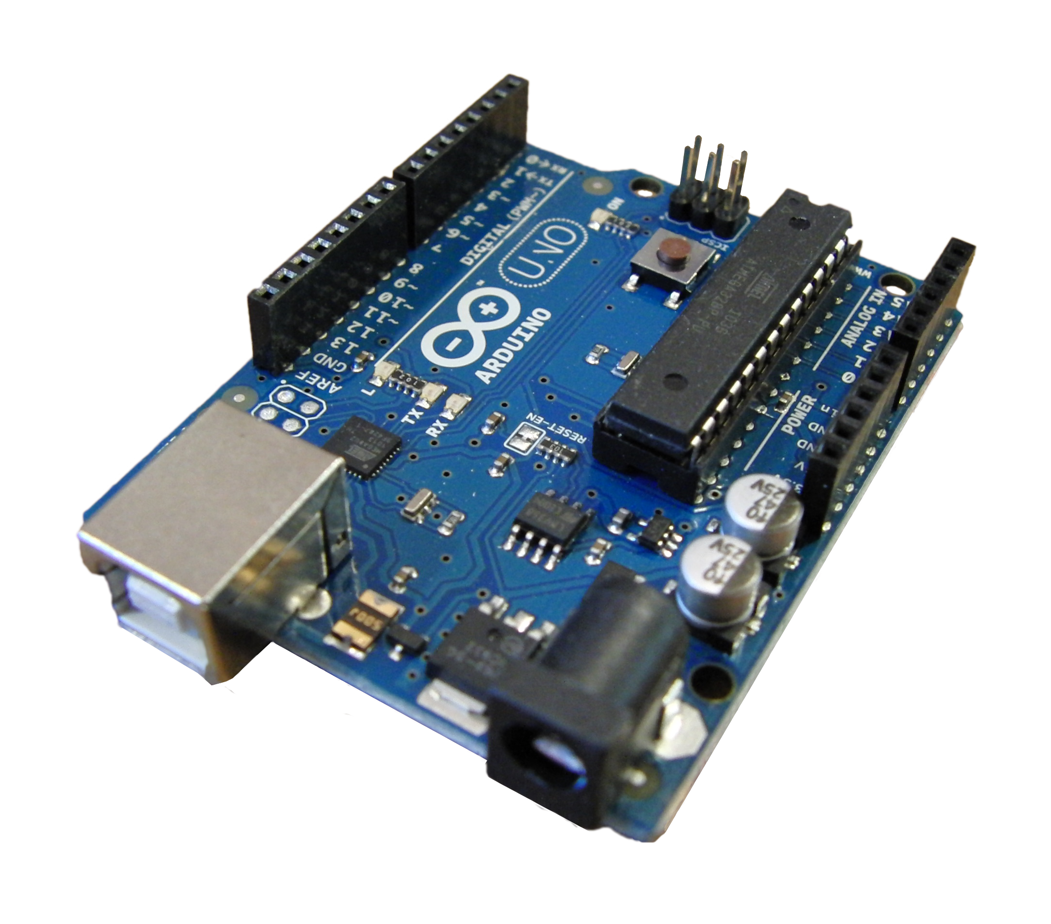
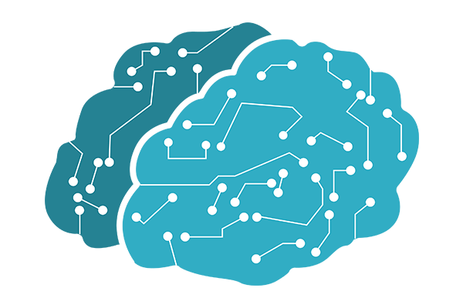

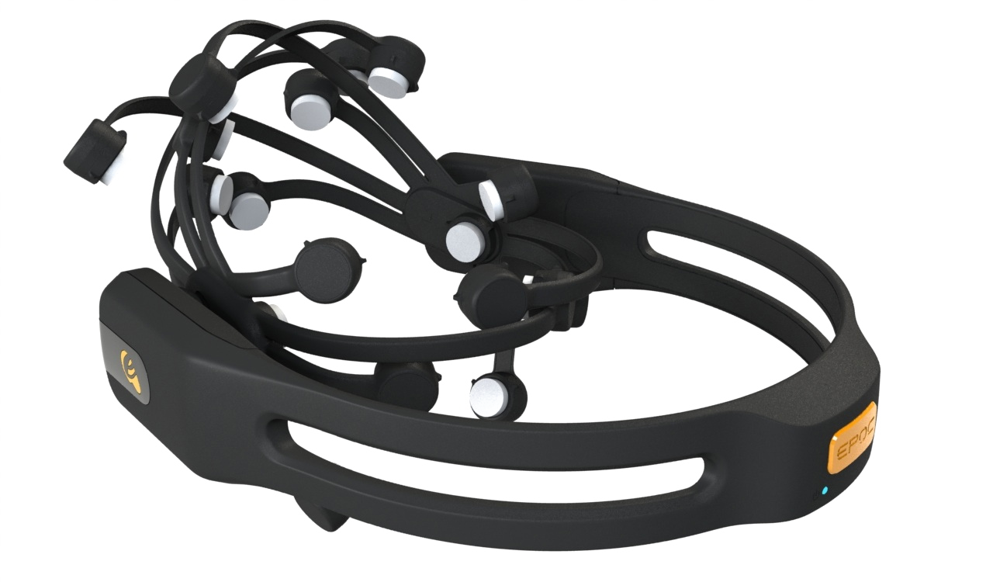


Project Requirements :
EEG Device
EEG Control Panel
OpenVibe
MATLAB
Testbench
Knowledge of :
Machine Learning
Data Analytics
Basic Electric Engineering
C++/Python
Notes:
A thorough knowledge of the following subjects and tools is required for proper understanding of the concept and its implementation:
Machine Learning: Deep learning will be used to train the model which would act on the dataset.
Data Analytics: Before giving the data as input, because it is highly noisy, it has to be preprocessed using various preprocessing techniques.
Basic Electrical Engineering: To study the signals and potential difference values provided by the EEG device.
C++/ Python/ MATLAB: For coding the model and performing operations on dataset.
EEG Control Panel: For visualizing the data and training the subjects.
OpenVibe: For extracting the data from the device.

Slide 5
Purchases Required
Product Name | Quantity | Price / Piece | Total Price
EMOTIV EPOC+ - 14 Channel Wireless EEG Headset | 1 (Already acquired) | Rs. 20,000 | Re. 0
Arduino Uno R3 with USB Cable | 1 | Rs. 500 | Rs. 500
Jumper Wires | 40 | Re. 0.5 | Rs. 20
DC Motors | 4 | Rs. 30 | Rs. 120
Bluetooth Transceiver Module | 1 | Rs. 400 | Rs. 400
4 Wheels Chassis |  | Rs. 800-Rs. 1200 | Rs. 1200
Total |  |  | Rs. 2240

Slide 6

Objectives
To study research papers and other literature related to Brain Computer Interface.
To gather data and preprocess it to remove ambiguities.
To develop Machine Learning algorithms for classification.
To control various devices based on what one thinks.
Test and validate the final system.

Slide 7
EEG Data Acquisition
Classification using Machine
learning
Application Interface Construction
Data Preprocessing
The subject after wearing the Emotiv headset, will be asked to perform an action at specific time intervals. Each EEG session will be recorded in the Emotiv’s Testbench.
PROJECT EXECUTION PLAN
The data collected from each subject will be processed in order to remove noise. Average of similar EEG recordings corresponding to each subject will be calculated.
To train a classification model for classification of the thoughts of Emotiv users based on the EEG signals received into five discrete brain thoughts.
Hardware Assembly
Notes:
Data Acquisition
The goal is to collect EEG signal data of 15-20 subjects. The subject after wearing the emotiv headset, will be asked to perform an action (blinking or hand movements) at specific time intervals. Each EEG session will be recorded in the Emotiv’s Testbench program as an EDF file. Testbench also has a converter utility which makes .edf files into .csv files. Thus, the final data would be five distinguished brain states of all subjects collected in .csv format.
Data Preprocessing
The data collected from each subject will be processed in order to remove noise. Average of around 50 similar EEG recordings corresponding to each subject will be calculated. This is a key step for noise reduction in the EEG signals.
Classification using Deep Learning
Main objective of this step is to train a neural network (using Python-Keras) for classification of the thoughts of the emotiv users based on the EEG signals received into five discrete brain states. Aim is to achieve a high accuracy by adjusting and tuning of various parameters.
Application Interface Construction
Construction of an API will be useful for mapping of the actions or thoughts of the users obtained from their EEG signals to the physical actions we want as an output. In our case, we will be mapping the user’s five discrete brain states to the four different kinds of motor movements (forward, backward, left, right and stop) in the wheel chair.
Hardware Assembly
This is the last phase of our project and includes the assemblance of Arduino microcontroller (along with Xbee) or Raspberry pi microcontroller to operate the modules (forward, backward, left, right, stop) and transmit the instructions though a wireless medium to the wheelchair and make it move or stop.

Slide 8
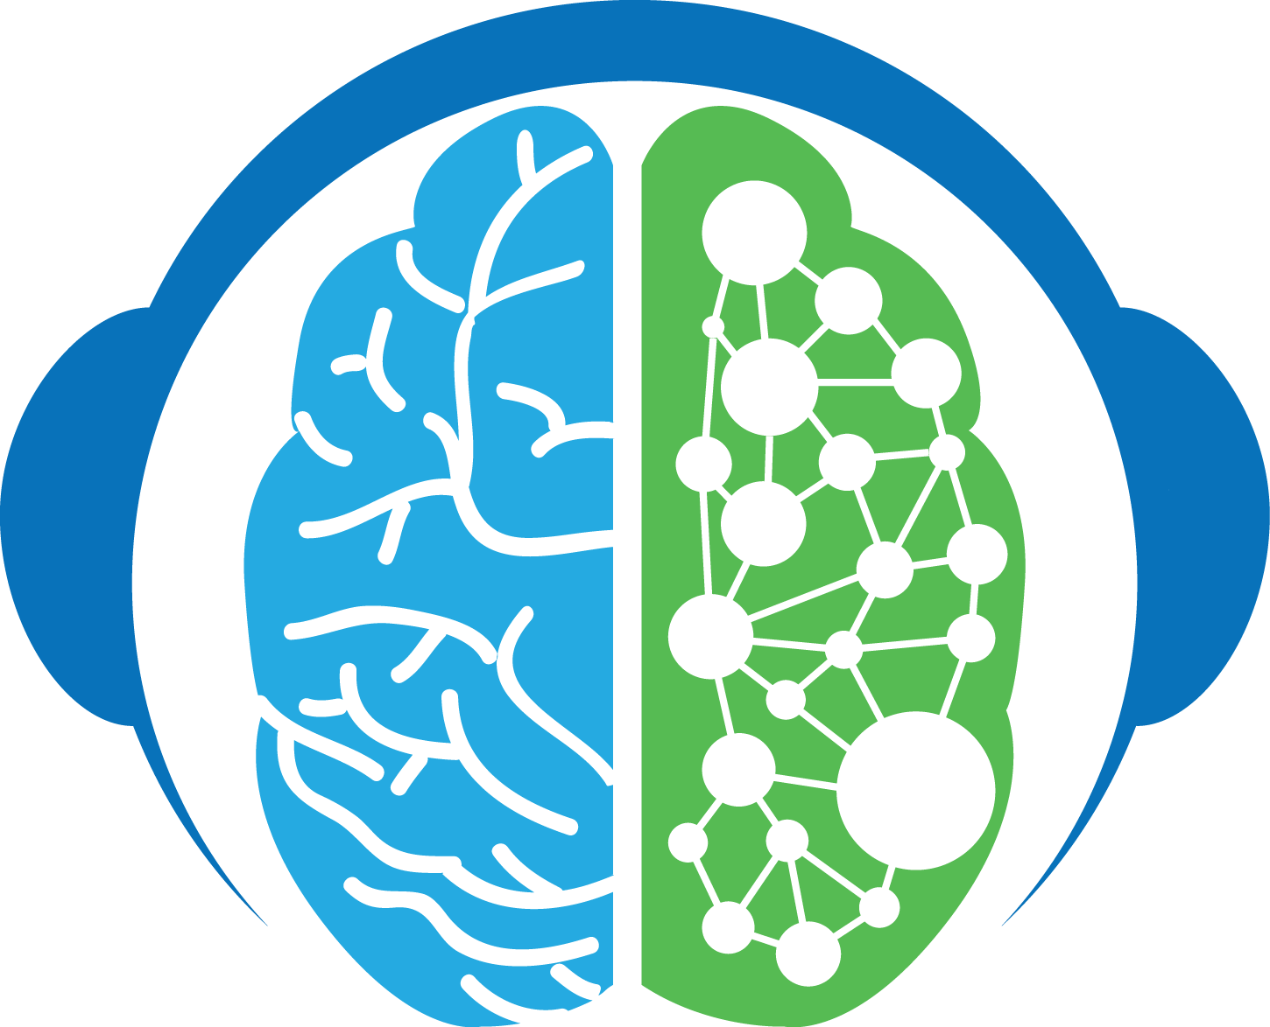
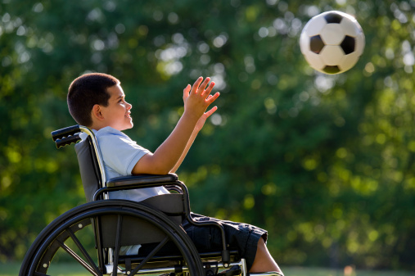
Outcomes
Develop a system for hospitals for people who cannot walk or speak.
Patients with disabilities will find a new way to move themselves or the things around.
Bringing in specific thoughts in the mind and forbidding others, would in general help increase focus.

Slide 9
Work Plan
Sr.no | Activity | Feb | Mar | Apr | May | Jun | Jul | Aug | Sep | Oct | Nov
1. | Literature Survey
2. | Data Collection and Pre-processing
3. | Model Training and Test
4. | Hardware Interfacing
5. | Testing and Validation of System
6. | Final Report

Slide 10
Member Contribution
Data acquisition and pre-processing.
Classification using Machine Learning Models
Software and Interface development and documentation
Hardware Interfacing and IOT implementation

